Slide 1





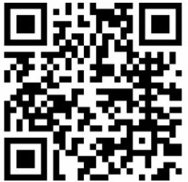


First General Meeting
Featuring PG&E
E
7:00
6:00
6, 2024
1001
pm – pm
Room Tschannen
Feb
Enjoy Some Free Food
Enjoy Some Free Food
Scan QR Code for Free Swag
Learn about internships and early career opportunities.
Connect with fellow Sacramento State alumni.
Network with PG&E recruiters.
Society of Hispanic
Professional Engineers

Slide 2

Second General Meeting
Featuring Royal Electric
Room Tschannen 1001
Enjoy Some Free Food
-Tschannen Science Complex
Date February 13, 2024
Time – 5:30pm – 7:00pm
Connect with professionals from Royal Electric.
Learn tips and tricks for future interviews.
Bring a copy of your resume for development and enhancement.
Society of Hispanic
Professional Engineers

Slide 3

Special Guests
Whiting-Turner
Third General Meeting
7:00
6:00
6, 2024
1001
pm – pm
Room Tschannen
Feb
Enjoy Some Free Food
Go Cowboy’s
Brock Purdy is overrated
Bang bang niner gang lmaooooooo
Society of Hispanic
Professional Engineers

